Slide 1
Case studies on using Machine Learning in the Aluminum industry
Amit Dingare
amit.dingare@novelis.com

Slide 2
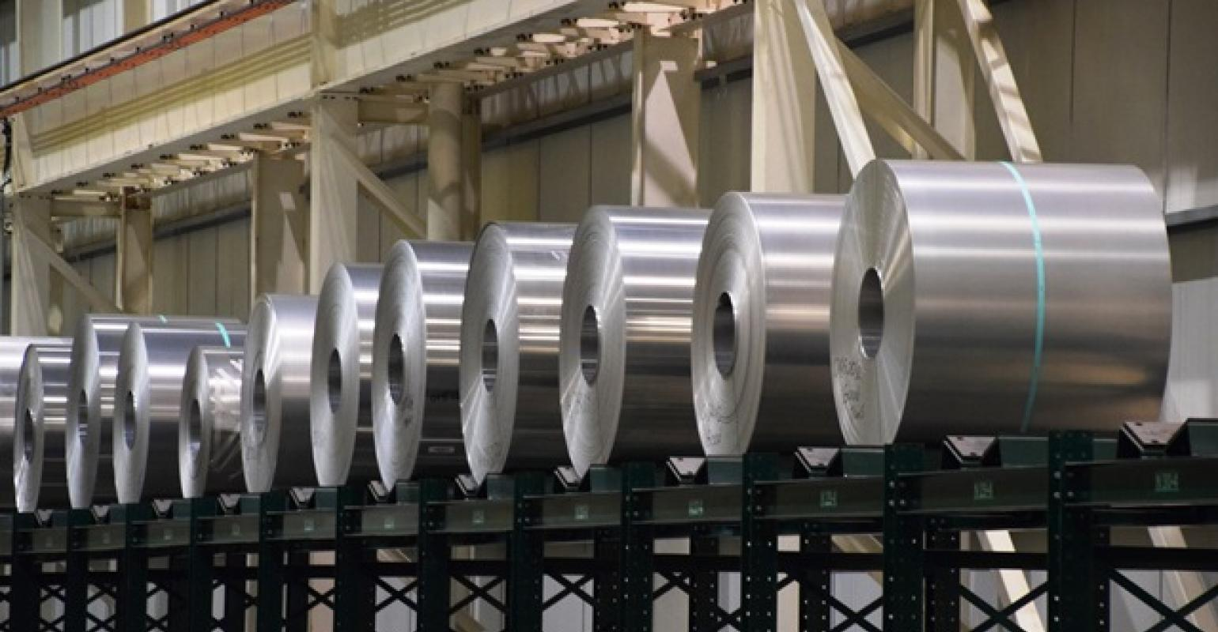
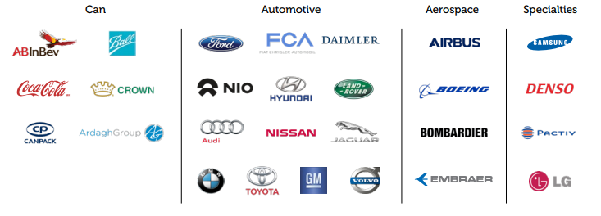
Who are we?
Novelis is the leading producer of flat-rolled Aluminum products
We are world’s largest recycler of Aluminum
We supply rolled Aluminum products to beverage can, Automotive, Aerospace and Specialty product segments

Slide 3



Novelis at a glance
 | Employees | Operations | Countries
Global | ~15,000 | 33 | 9
North America | 5,900 | 16 | 2
South America | 1,600 | 2 | 1
Europe | 6,200 | 11 | 4
Asia | 2,000 | 4 | 2

Slide 4
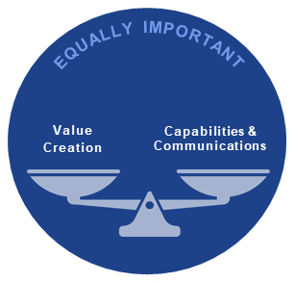
Digital at Novelis
The Digital CoE was established to expedite application of digital technologies
Focus is on operations and supply chain
we leverage Advanced Analytics techniques such as Machine Learning, Linear and Non-linear Optimization, Simulation and Bayesian Statistical Modeling to name a few
Our Dual Mandate

Slide 5
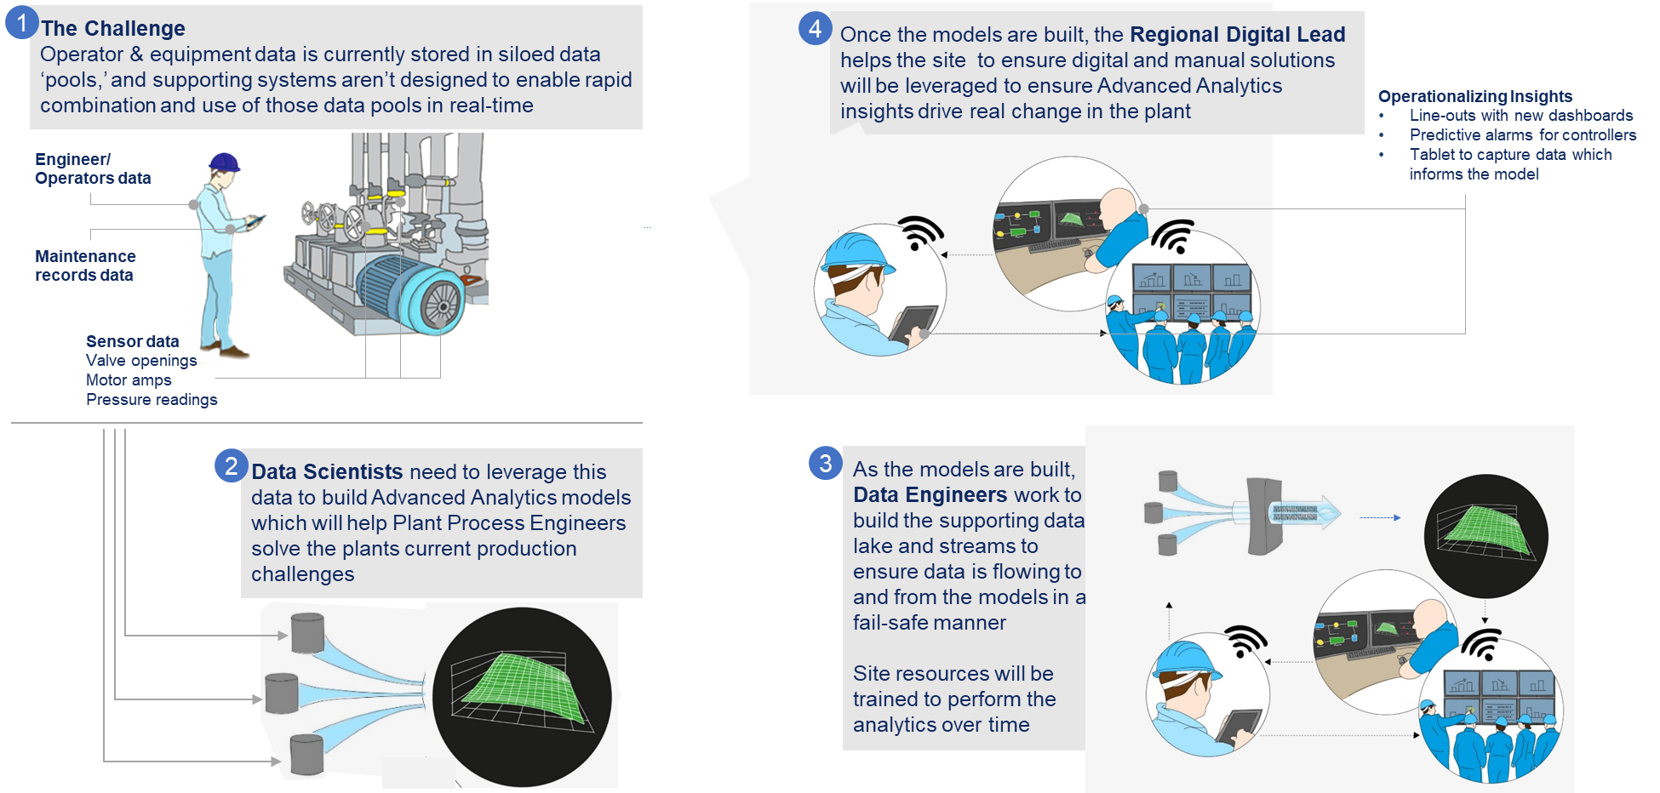
How the Digital works within Novelis

Slide 6
Geographic digital presence
Remelt Model Optimization
CASH Line Recovery Improvement
Metal Flow Optimization
Auto Demand Forecasting
Remelt Pot Chemistry Optimization
Project Trifecta
Furnaces Temp Optimization
CASH Line Dynamic Recipe Control
Metal Flow Optimization
Remelt Productivity
CASH Line Shape Control
High Bay Storage Optimization
Q23 Tension Model
Alloys Hardeners (W7)
Cold Mill Scratch Gouge
Hot Mill Cobbles
Hot Mill Pick Up
Cold Mill Vibration – 5th Octave
Remelt Efficiency
Improve NG consumption at Side Melter
Reduction Black Dross rate
Improve HT TPH Cycle
Increase de-coater rate speed
Remelt Energy Efficiency
De-bottleneck Bay 6
CM3 Bad Starts
Remelt RSI (Holder) Phase 1 & 2
HFM Predictive Maintenance
Optimal Casting Phase 1 & 2
Project with customer: Ball
Reci Fan Analysis

Slide 7
Case study 1

Slide 8
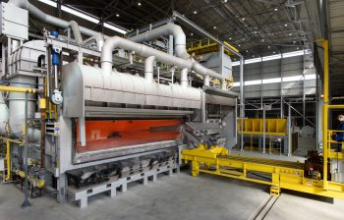
Context behind the use case
Historical melt time predictions were inaccurate. This often resulted in “overcooking” of the molten.
This not only increased the process time, but, also the wait time for needed to bring the molten down to the temperature needed for the next process
Because operators didn’t trust the melt time shown on the screens, they often opened the door of the furnace to sample the molten
This action led to loss of heat from the furnace, thereby increasing the fuel requirement of the furnace
Frequent main door opening was also unsafe
Also kept the operator occupied in unnecessary tasks

Slide 9
Summary
Use Case Purpose
Increase throughput of the remelt process by increasing the accuracy of time to melt
Avoid heat loss as a result of frequent door opening for validation -> save energy
Use Case Scope & constraints
3 Furnaces
Not physically changing the furnace
Avoid CAPEX
Avoid major changes to operating procedures
Solution:
To build a model that will leverage data collected and accurately inform when the batch is complete.

Slide 10
Evolution of the model
Before
After
High variance
One Thermodynamic equation for all alloys
Equation based on weights
Separate Thermodynamic constants (latent heat of fusion, melting points etc.) are used by alloys
Equation changed to use surface area in addition to the weight
A machine learning based approach was used instead of thermodynamics
The model, while reduced the average melting time, increased the variance
A machine learning based approach with thermodynamics at its base yielded the best results
Thermodynamics serves as the basis and other features help in explaining the noise

Slide 11


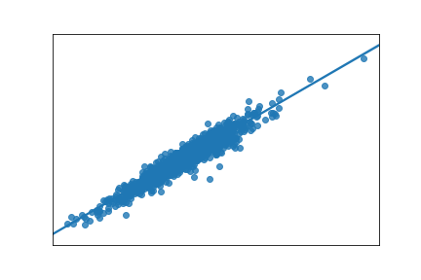
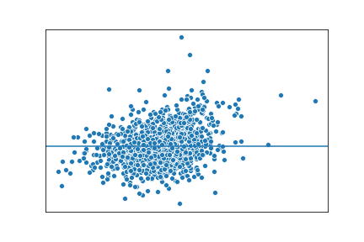

Model and Results
Terabytes
Gigabytes
Megabytes
Final random forest model
Variable importance of all 10 included features
Total theoretical heat need
Feature
generation
Informed design
feature1
Train
feature2
PI
feature3
$$≈$$
feature4
feature5
Database
Test
feature6
feature7
118 candidate features
Temperature corrected BTU
feature8
Remelt
Database
Feature9
Out of sample model performance
On 20% random test sample, 80% train
Actual vs predicted
Residual plot
Performance metrics
~95% adj. R²
8.48% RMSE

Slide 12
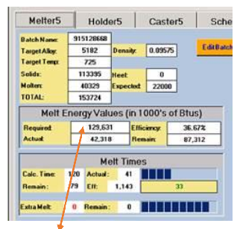
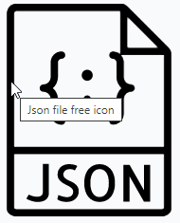

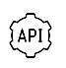
Model Architecture
PI
Remelt
Database
Automation Interface Layer (AIL)
Model API is called every 3 minutes
Predictions
Feature Engineering
HMI
Model deployed to
Server in the plant
as a RESTful API

Slide 13
Case study 2

Slide 14
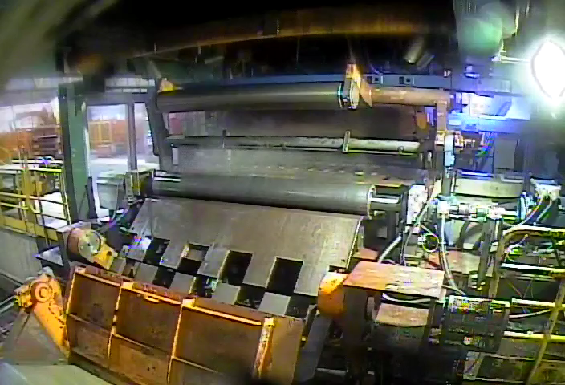
Context behind the use case
Rolling operations require operators to enter 4 starting parameters
These parameters depend on
the coil profile of the current coil from pervious rolling operation
Ending values of these parameters from the previous coils
Operators leverage their experience and domain knowledge to enter these parameters
However, if previous rolling operations produce coils with edge cases, operator entries could lead to bad starts
These generate high scrap losses
And unplanned machine downtimes
Solution: Derive the parameters through an ML model and present those to the operators

Slide 15
Complexity and the solution
Model Training
Prediction needs to be done in almost near time
Average gap between two successive coils is 135 Sec on average
Ending parameters from the previous coil needed to be joined with data for the current coil to generate features
The parameters needed to be made available to the users through an UI
Bad starts were captured under generic downtime bucket, so target data was muddy
Past Data
Filter out Bad Starts using TBC
Data Joining, Cleansing &
FE
4 Regression Models
Models deployed to
Edge as a RESTful APIs
Prediction
SQL
Features from previous Machining Operations
Data Joining, Cleansing &
FE
Call Model APIs
UI
Historian
- Ending values for the parameters from the prev. coil

Slide 16
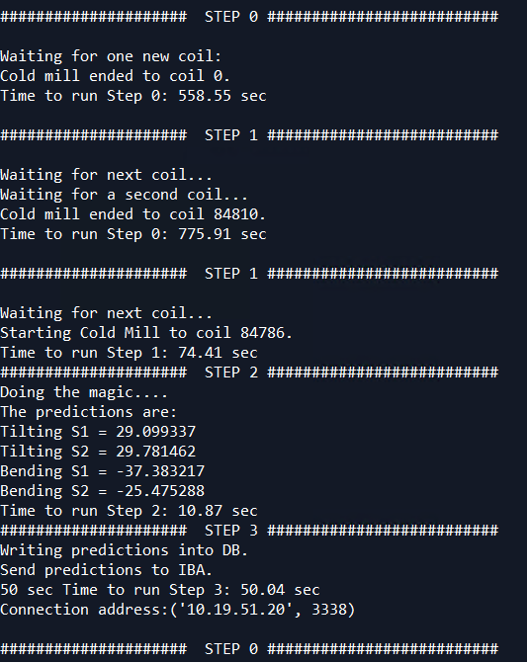
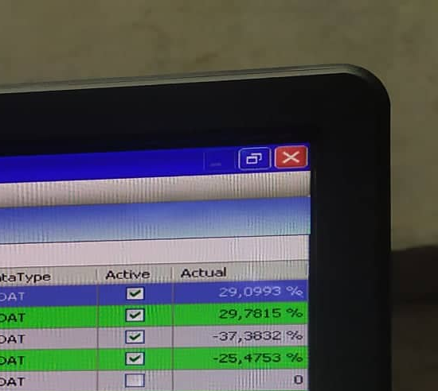
Output
Predictions Generated
Predictions are shown to the users through an UI

Slide 17
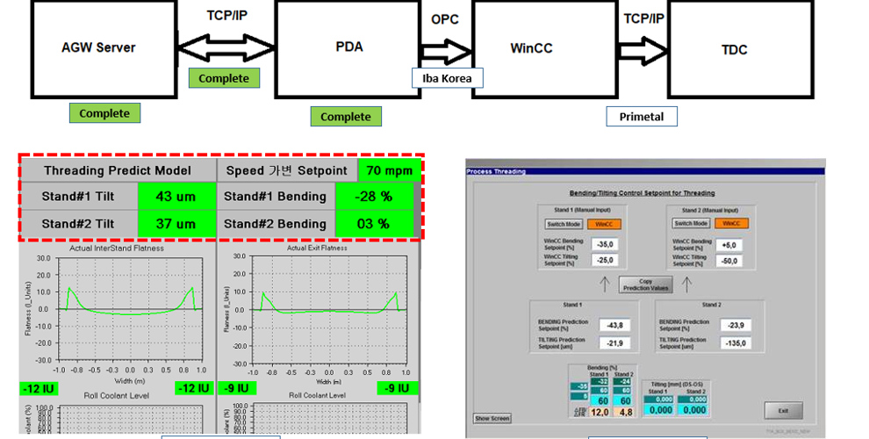
CM3 Bad start with Predictive model
the automation for the input values from predictive model to HMI with Cold mill automation team. After this schedule, it will be continuously updated by the feedback of Operation in Cold mill

Slide 18
Key Takeaways
Metals manufacturing = large data tracked through thousands of sensors at a small time interval. Big Data in every sense.
From statistics, linear modeling -> non-linear modeling
Do not ignore basic sciences (Physics/Thermodynamics) while building ML models
Advanced Analytics is a strategic value driver and hence, building capability within operations is essential

Slide 19
Thank You
For any questions, please reach me out at
amit.dingare@novelis.com

Slide 20
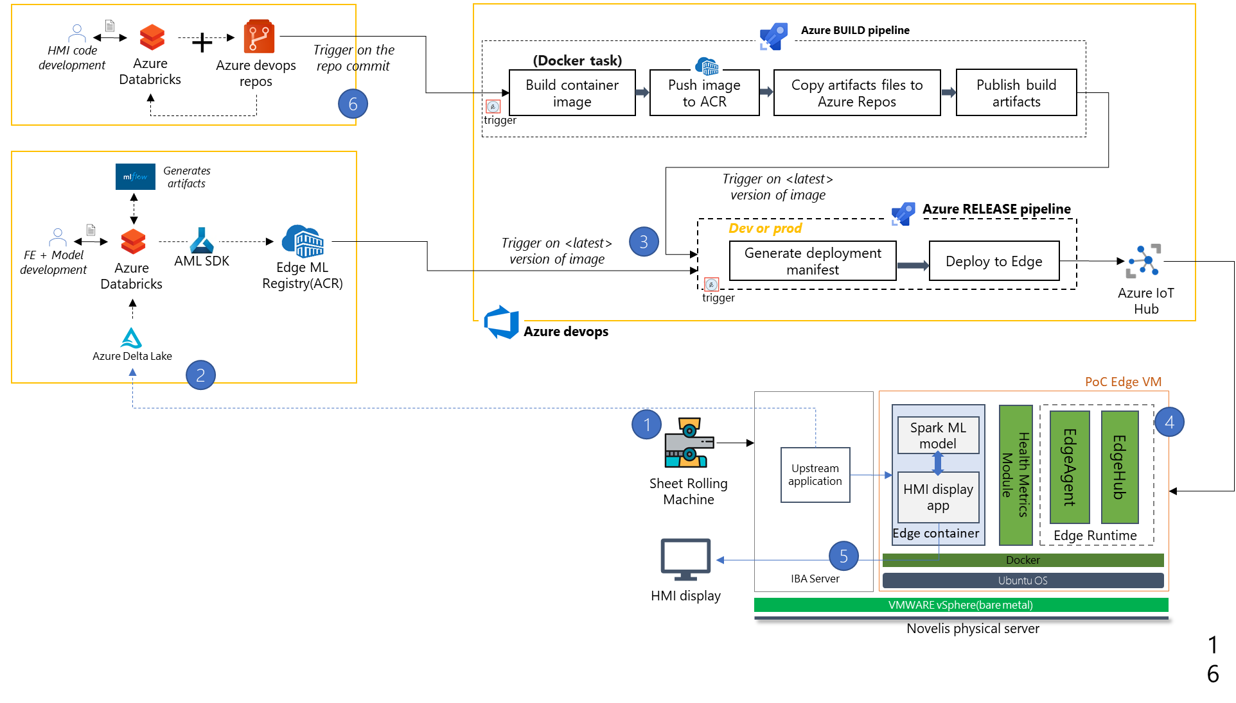
Model deployment Architecture

